Slide 1
COMPUTER NETWORKS
Assignment 1 part 2 ( video + pcap file)

Slide 2
01
INTRODUCTION
Assignment 1

Slide 3
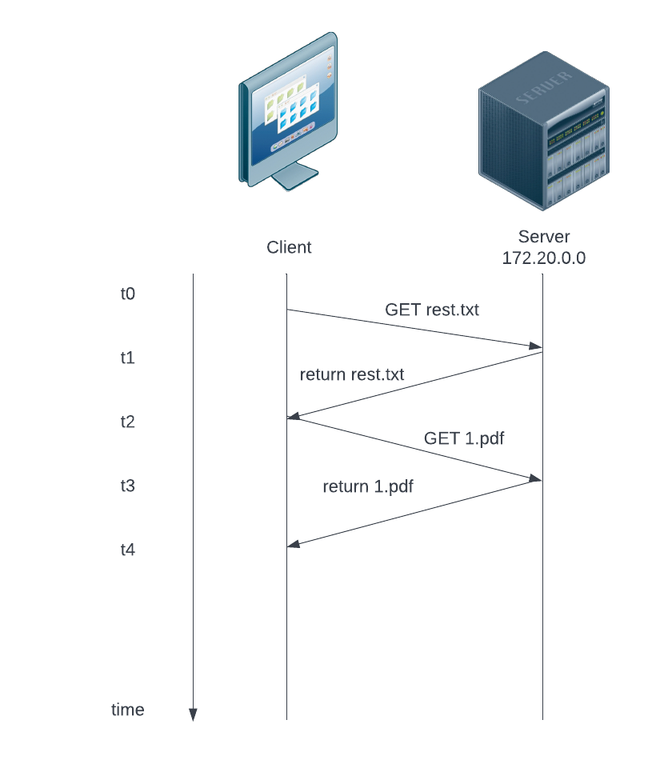
First part
That was my submission for part 1 , it only involves client and a server
Now I included workers and made it work with sending and retrieving small and big files

Slide 4
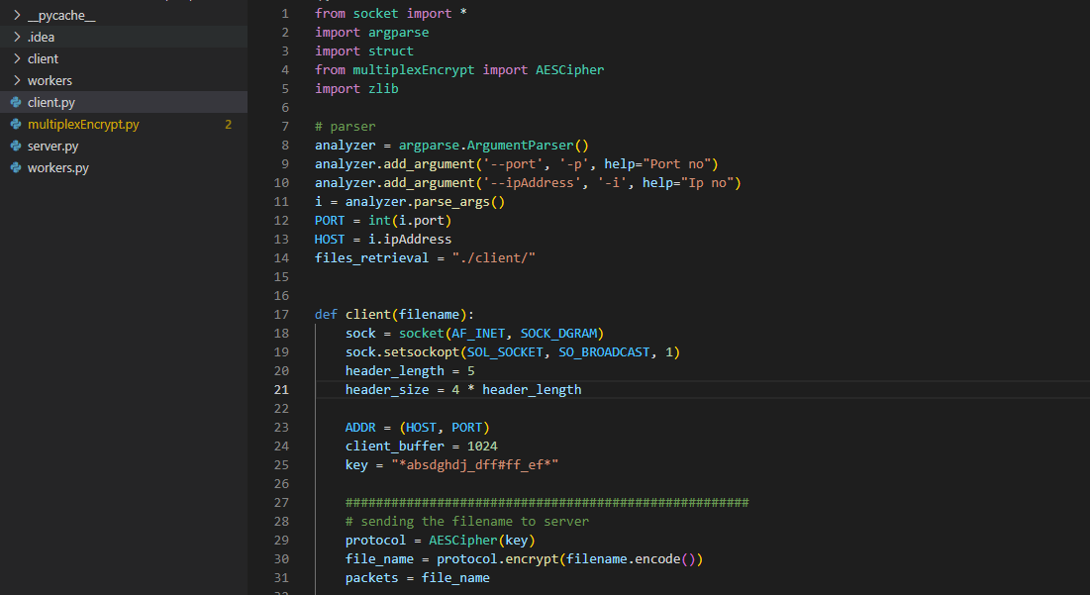
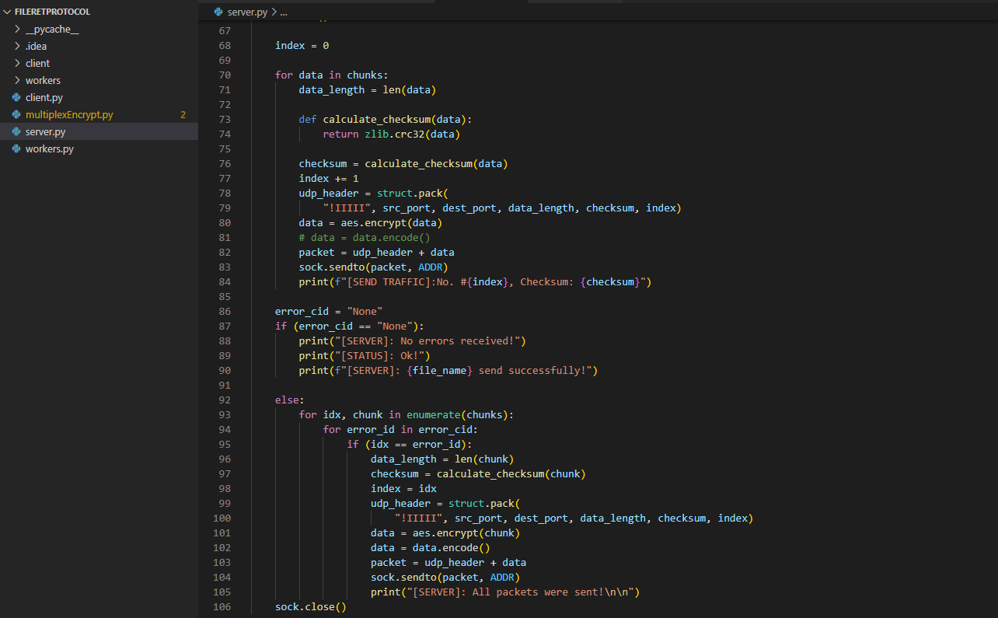
Python Scripts
☺

Slide 5
Implemented functionalities
What I am using
Forward Error correction
Multiplexing
Encryption

Slide 6
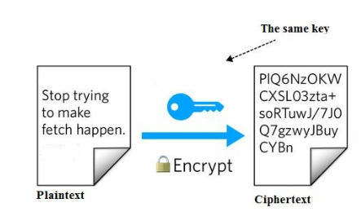
ENCRYPTION
AES which is the advanced Encryption standard
I am using it cause :
Very secure
Fast
Can be implemented easily using a library in python called “ pycryptodome”

Slide 7
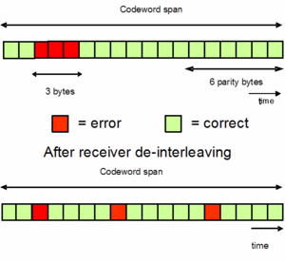
Forward Error correction
We count the amount of packets coming from the server, calculate the number of packets that are missing, and if that calculation returns with the missing packets, we request it from the ingress. To see the capability of forward error correction, the server must send them back again.

Slide 8
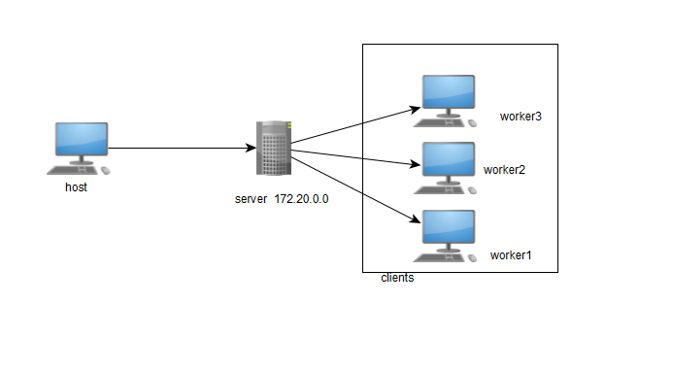
What I achieved
I have developed a python script that utilizes UDP datagrams to send and retrieve files from the server to clients(workers).
The design involves the following;
Host(sender)
Server = ingress
Clients = Workers

Slide 9
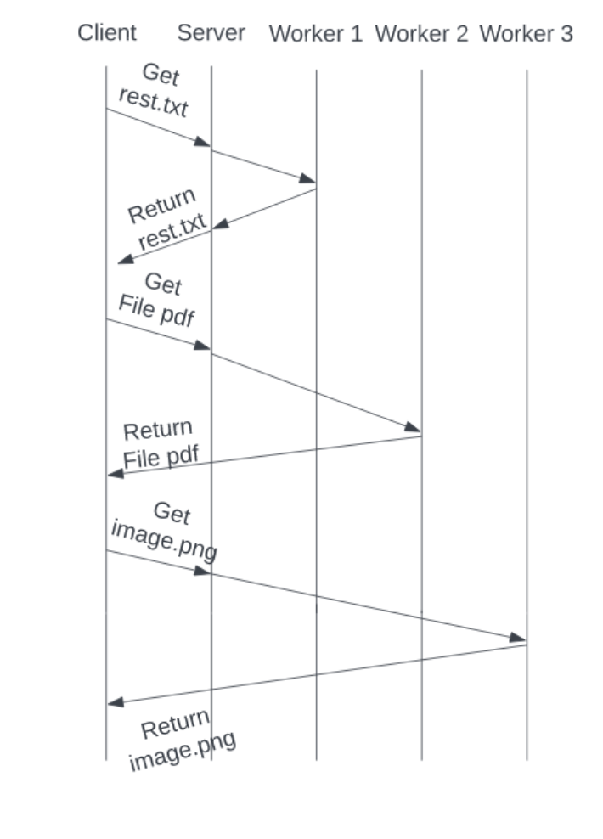
Topology Explanation
When the server is operational, clients can make multiple file requests. I accept several files that he can ask for as input for this example. The data is sent to the server through our newly established UDP header when we are asked for the file names. After finding the file among the three workers, it returns it to the client.

Slide 10
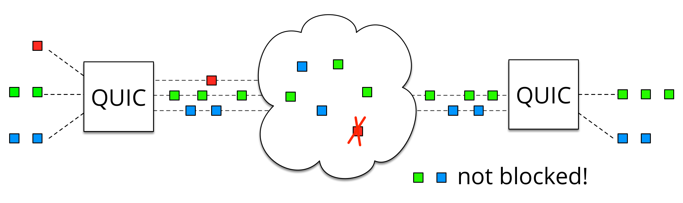
Multiplexing – Next Step
is a way of sending multiple signals or streams of information over
a communications link at the same time in the form of a single, complex signal.

Slide 11
Thanks for listening
Aziz

